Slide 1


Notes:
Select desired slide show or slides----Slide Shows: Grocery, Softlines/Fashion, General Retail, Wholesale/dist, ALL

Slide 2

Optimized Planning Success Factors
Processes
People
Tools
Corporate & Strategic Direction
Est. Strategies
Strategic Planning
Category Goals
Internal & External
Analysis
Product Planning
Channel Planning
Define Category Goals
Assortments
Demand Plans
Allocation
Product / Channel Planning
&
Brand Management
Demand Forecast
Channel Clustering
Top Down Plan Targets
Exchange
Layer
Reconciliation
Bottom up Plans
Replenishment
Finance Management
Implement Strategies
Execution
Operations Management
Promotional Planning
Analyze Performance
Review / Adjust Plans
Space Performance
Corporate Calendar
Re-plan

Slide 3
Merchandise Planning
Why develop Merchandise Plans?
  Ensure customer expectations are met
  Provide a base for better buying
  Strategically manage inventory investments
  Realize strategy
  Achieve consistent, integrated approach
Notes:
commonly, planning is done to create and meet financial objectives
a properly executed plan enables buyers to approach sourcing and negotiating from a much stronger base (eg. I need this many options and they have to generate this gross margin)
most often approached from a “last year as base” approach; best practice incorporate sales and productivity objectives (eg. ROS, GMROI) with space (linear)
must incorporate other company objectives eg. market growth, product expansion and/or contraction, new/refurb. stores, financial targets
to develop the PERFECT PRODUCT MIX AND BALANCE IN PERFECT QUANTITIES!!!!

Slide 4
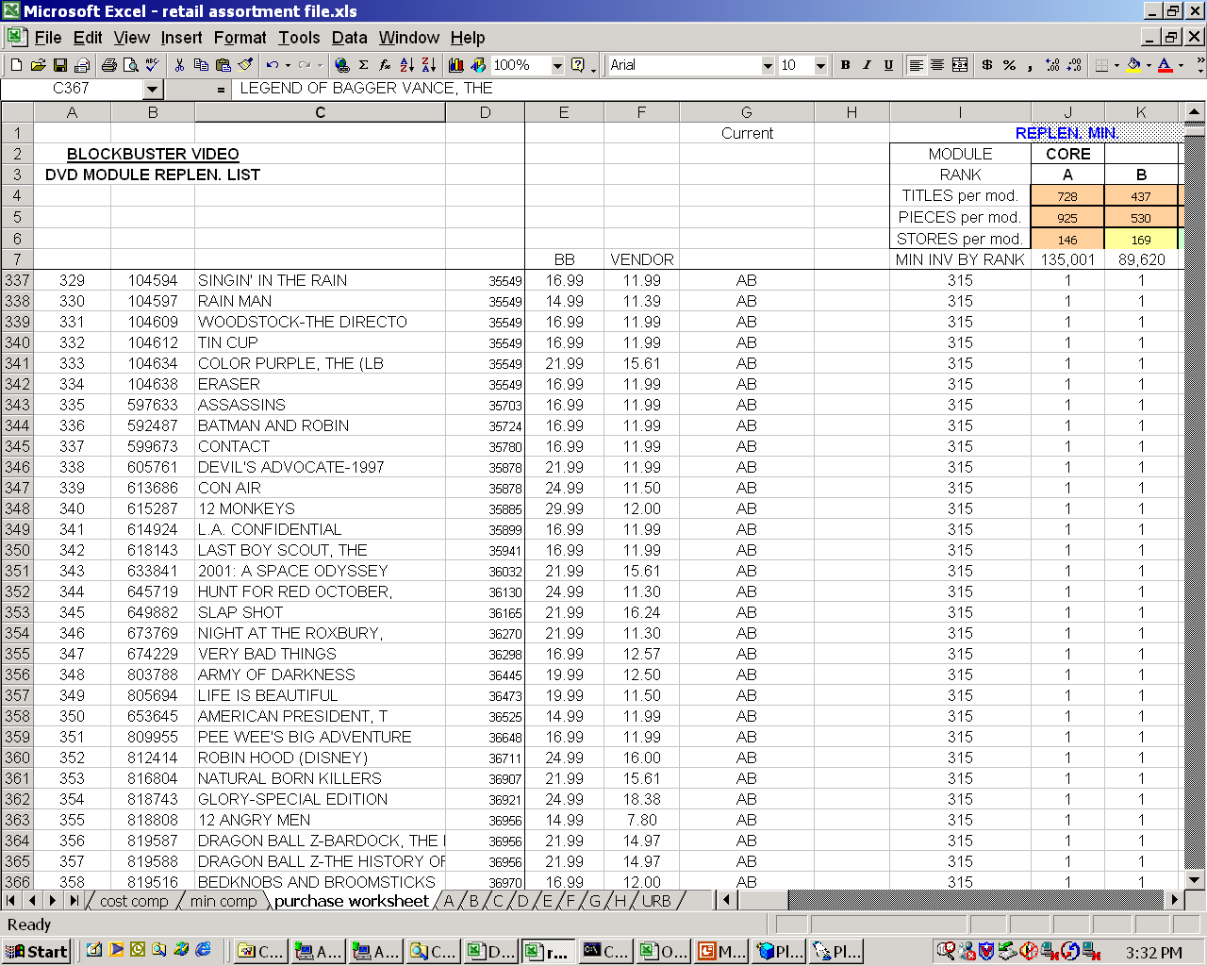
Two dimensional Planning
Chain Planning
Store Planning
Marketing
Finance
Data is in each spreadsheet
Macros are a nightmare
Who knows it all?
Circular references
What are the relationships?
What if we change our process?

Slide 5
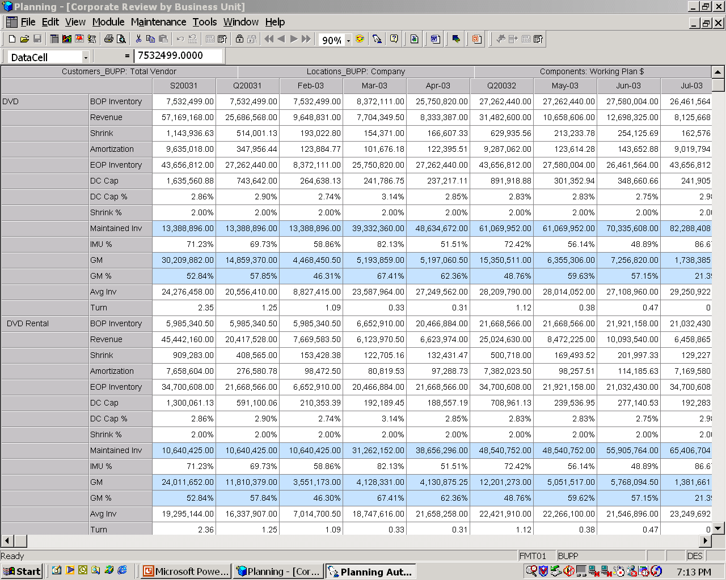
Multi Dimensional Planning
Views of the data
Rules & Data
Products
Channels
Business Measures
Time
Versions
Vendors

Slide 6
Multi Dimensional Planning
Rules & Data
Chain
Products
Channels
Business Measures
Time
Versions
Vendors
Products
Store
Finance
Channels
Products
Products
Channels
Channels
Business Measures
Business Measures
Business Measures
Time
Time
Time
Versions
Versions
Versions
Vendors
Vendors
Vendors

Slide 7
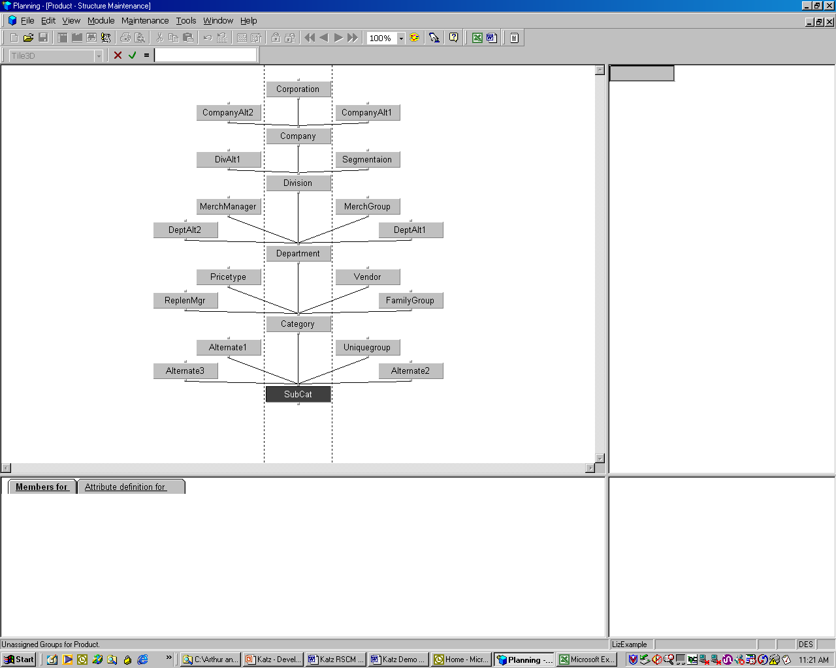
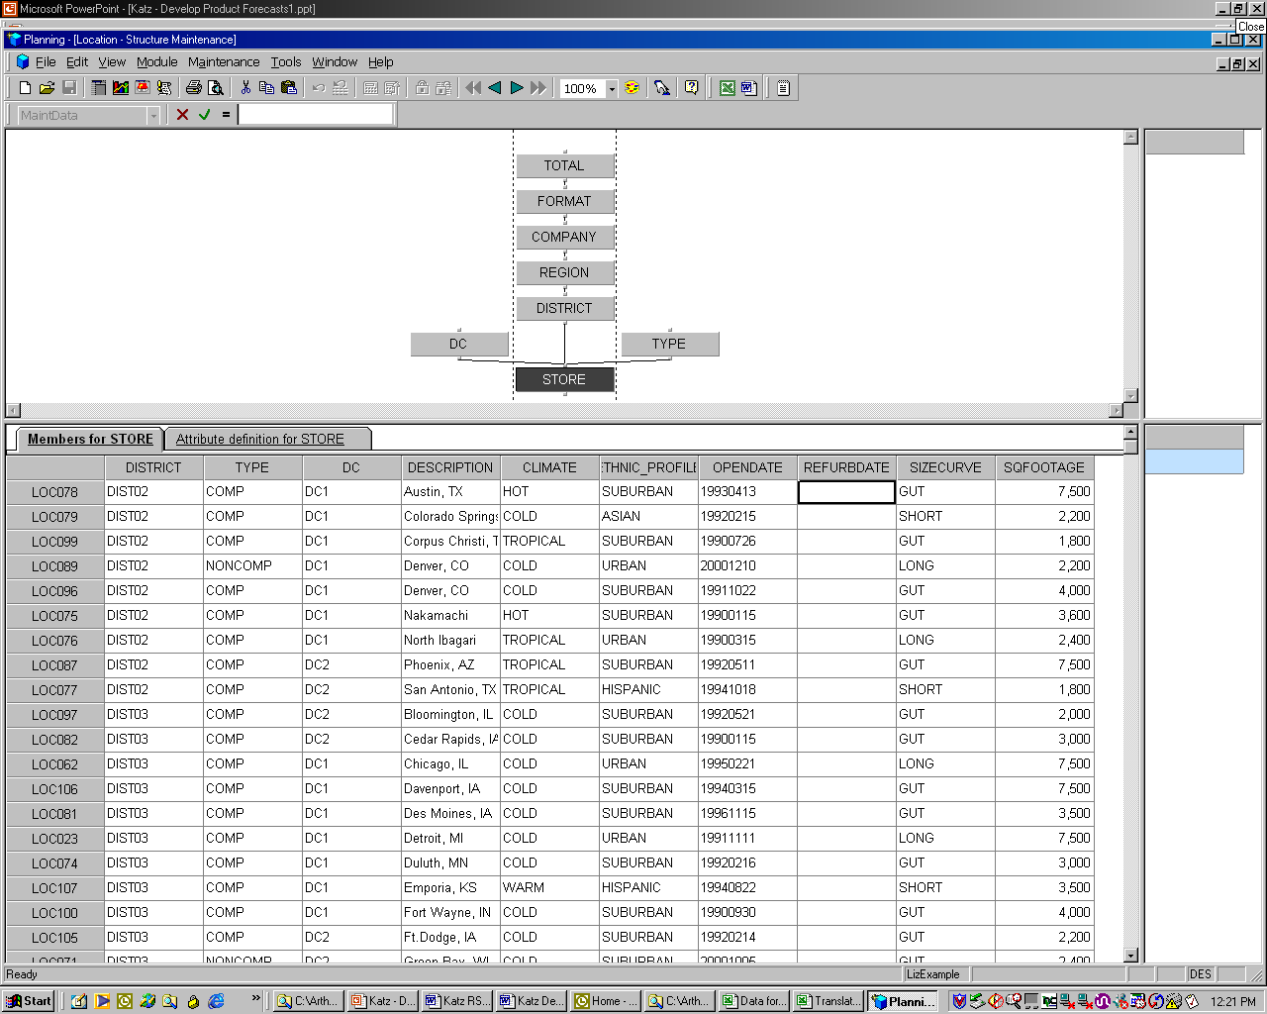
Today's Planning Environment
Top Down Plan
Alternate
Total
“Buyer”
Division
Bottom Up Plan
Department
Department
Class

Slide 8
Notes:
Select desired slide show or slides----Slide Shows: Grocery, Softlines/Fashion, General Retail, Wholesale/dist, ALL

Slide 9
Forecasting
Top Down- Baseline Plans
  Lowest Level in Merchandise Plan by Location
    Simple Exponential Smoothing
    Simple Moving Average
    Weighted Moving Average
Bottom Up – SKU Replenishment
  SKU/Location
    Variable Response Smoothing
    Alternate Forecasting

Slide 10
Forecasting Challenges
  High Number of SKUs and “New’ SKUS
  Wide Range of Demand Rates
  Highly Seasonal
  Few Buyers in relation to the huge number of SKU/Loc
  Buyers typically not statistically oriented

Slide 11
Top Down Forecasts
Simple Exponential Smoothing
  Value is smoothed to a weighted average of itself and the smoothed value of the previous period.
Simple Moving Average
  Values are smoothed to the average of itself and its neighbors. Users select the neighbors, (lag), (lead), (window).
Weighted Moving Average
  Each value is smoothed to the weighted average of itself and its neighbors
    users you assign weights to each period.

Slide 12
SKU Forecasting
Variable Response Smoothing
  Calculates a forecast of future demand based on past historical data.
  Weights current historical demand heavier than older demand.
  Automatically assigns unique trending and deviation components to each SKU.
  Results in a more responsive and accurate forecast.
Notes:
When combining the VRS forecasting technique with the VRS derived forecasting components, you are essentially assigning a different forecasting methodology to each SKU. This is important in understanding why VRS is so effective in driving retail replenishment.

Slide 13
Forecasting
Alternate Forecasting Method
  For SKUs with very low and lumpy demand.
  Averages demand over the past year
  Empirically calculates effective order points to meet the SKUs service level goal.
    Tests different safety stock strategies
Notes:
Simulates different safety stock strategies to determine which one would have achieved the service target against last year’s sales patterns. Once it determines the appropriate strategy, it uses the safety stock level and the average forecast to set order points and order up to levels.

Slide 14
Forecast Sharing - Projections
Projects future demand and purchases a year in advance.
  Units and Dollars
  Region, Vendor and Store
Add an annual growth rate.
Help manufacturers with production and vendors with supply problems.
Assist warehouse management with labor scheduling.
Help management determine future cash requirements (OTB).

Slide 15
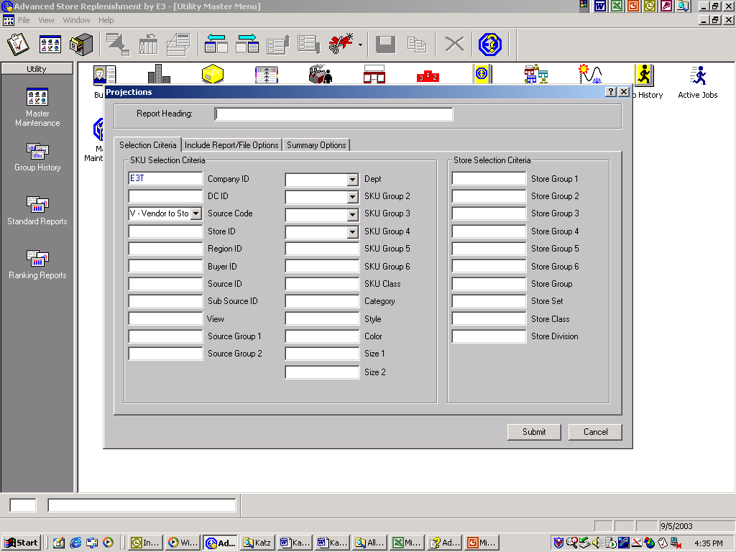
Forecast Sharing - Projections

Slide 16
Demand Forecast
Shipped + Lost – Promo
Channels can be set up as another store

Slide 17
“Supersede” Functionality
Transfer history and other key SKU components with the status to a replacement SKU.
Combine history and stock status for one or more SKUs
  (i.e. narrowing an assortment).
Copy history and other key SKU components to a new SKU

Slide 18
Substitution
Automatically substitute a SKU temporarily for a regular SKU.
  Indicate which substitution should occur and when
    Switches SKUs for replenishment during the substitution period.
  Use history and forecast of regular SKU to determine replenishment.
    Reverts to regular replenishment for the SKU after substitution period.

Slide 19
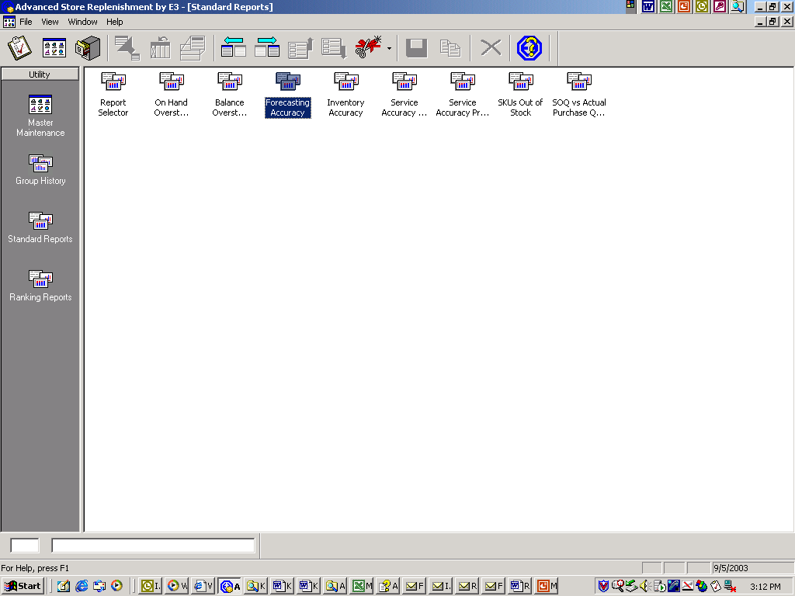
Forecast Accuracy Reporting
Compare actual sales to the expected sales predicted by the demand forecast.

Slide 20
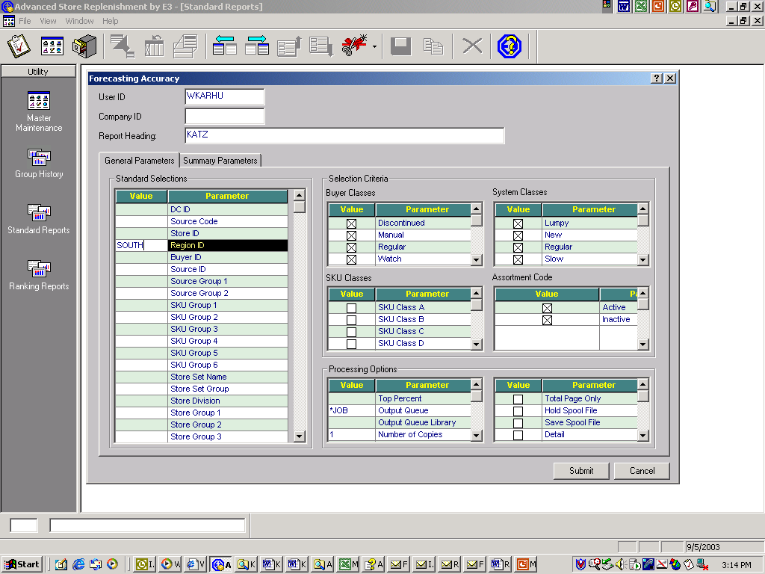
Forecast Accuracy
Sort criteria available for Forecast Accuracy Reports.

Slide 21
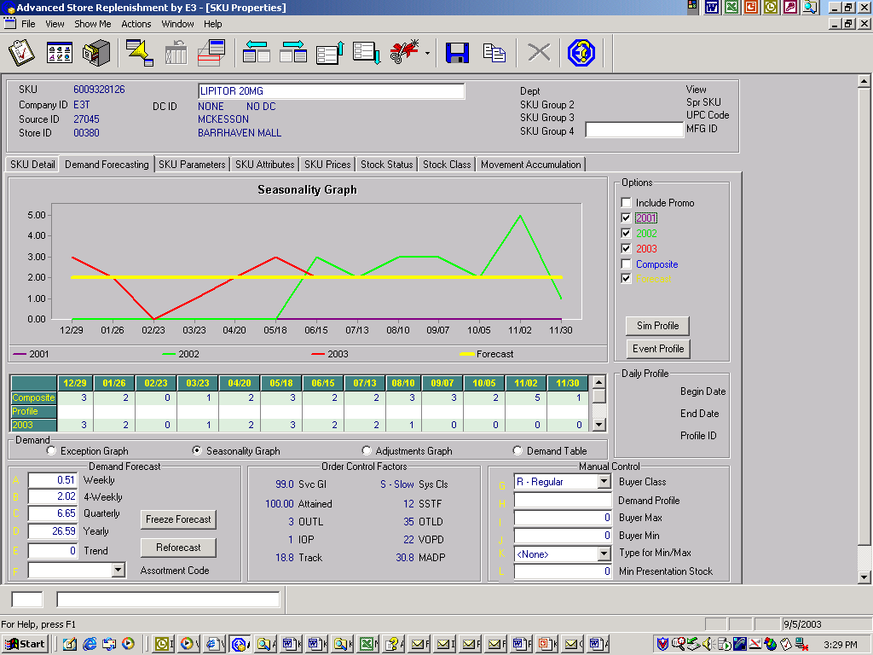
“What If” Capabilities
Service Level Goal is 99% - Resulting Safety Stock in Days is 12

Slide 22
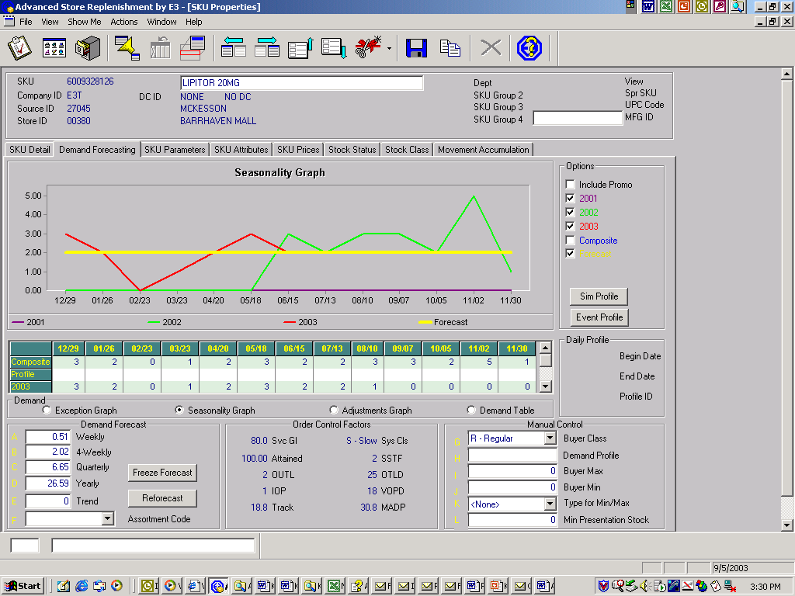
“What If” Capabilities
Service Level Goal is 80% - Resulting Safety Stock in Days is 2

Slide 23
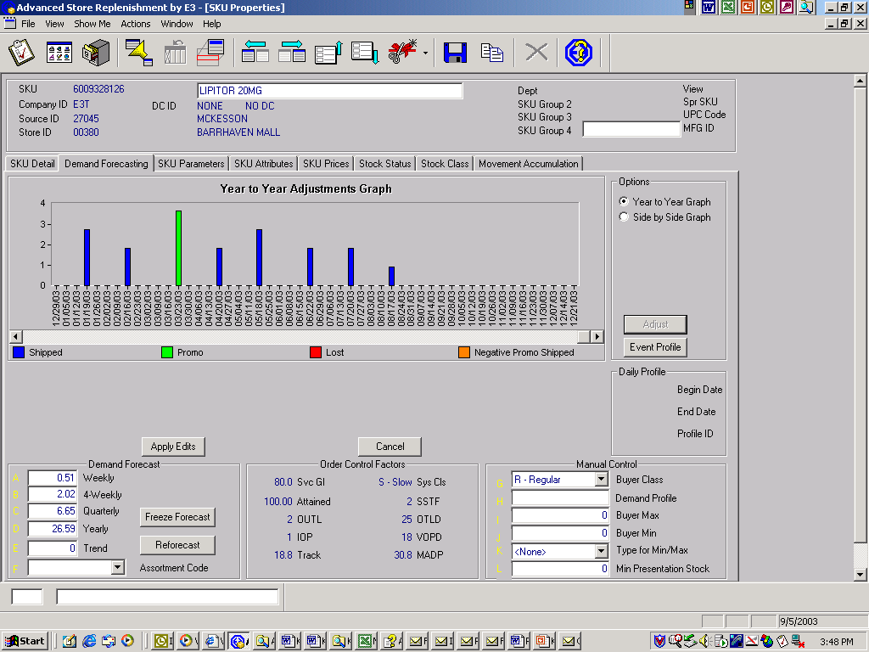
Segregating Promotional Demand

